Slide 1
Building Java Programs Chapter 18
Advanced Data Structures: Hashing and Heaps

Slide 2
Priority Queues and Heaps
Reading: 18.2

Slide 3
Warm Up Practice

Slide 4
Starting with the tree
What would the PQ of the following statements look like?
Add(40)
Add(41)
Pop()
Pop()
Add(10)
30
45
55
80
70
60

Slide 5
Implementing Heap PQ

Slide 6
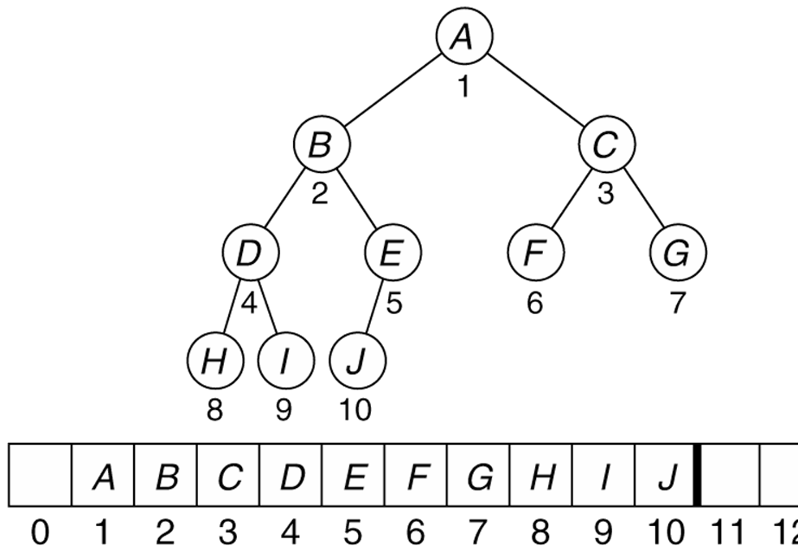
Array heap implementation
Though a heap is conceptually a binary tree, since it is a complete tree, when implementing it we actually can "cheat" and just use an array!
index of root = 1 (leave 0 empty to simplify the math)
for any node n at index i :
index of n.left = 2i
index of n.right = 2i + 1
parent index of n?
This array representation is elegant and efficient (O(1)) for common tree operations.

Slide 7
Implementing HeapPQ
Let's implement an int priority queue using a min-heap array.
public class HeapIntPriorityQueue
implements IntPriorityQueue {
private int[] elements;
private int size;
// constructs a new empty priority queue
public HeapIntPriorityQueue() {
elements = new int[10];
size = 0;
}
...
}

Slide 8
Helper methods
Since we will treat the array as a complete tree/heap, and walk up/down between parents/children, these methods are helpful:
// helpers for navigating indexes up/down the tree
private int parent(int index) { return index/2; }
private int leftChild(int index) { return index*2; }
private int rightChild(int index) { return index*2 + 1; }
private boolean hasParent(int index) { return index > 1; }
private boolean hasLeftChild(int index) {
return leftChild(index) <= size;
}
private boolean hasRightChild(int index) {
return rightChild(index) <= size;
}
private void swap(int[] a, int index1, int index2) {
int temp = a[index1];
a[index1] = a[index2];
a[index2] = temp;
}

Slide 9
Implementing add
Let's write the code to add an element to the heap:
public void add(int value) {
...
}
10
10
20
80
15
80
40
60
85
99
40
20
85
99
50
700
65
15
50
700
65
60

Slide 10
Implementing add
// Adds the given value to this priority queue in order.
public void add(int value) {
elements[size + 1] = value; // add as rightmost leaf
// "bubble up" as necessary to fix ordering
int index = size + 1;
boolean found = false;
while (!found && hasParent(index)) {
int parent = parent(index);
if (elements[index] < elements[parent]) {
swap(elements, index, parent(index));
index = parent(index);
} else {
found = true; // found proper location; stop
}
}
size++;
}

Slide 11
Resizing a heap
What if our array heap runs out of space?
We must enlarge it.
When enlarging hash sets, we needed to carefully rehash the data.
What must we do here?
(We can simply copy the data into a larger array.)

Slide 12
Modified add code
// Adds the given value to this priority queue in order.
public void add(int value) {
// resize to enlarge the heap if necessary
if (size == elements.length - 1) {
elements = Arrays.copyOf(elements,
2 * elements.length);
}
...
}

Slide 13
Implementing peek
Let's write code to retrieve the minimum element in the heap:
public int peek() {
...
}
10
15
80
40
20
85
99
50
700
65
60

Slide 14
Implementing peek
// Returns the minimum element in this priority queue.
// precondition: queue is not empty
public int peek() {
return elements[1];
}

Slide 15
Implementing remove
Let's write code to remove the minimum element in the heap:
public int remove() {
...
}
10
65
20
80
20
80
40
60
85
99
40
60
85
99
700
50
65
700
50
65

Slide 16
Implementing remove
public int remove() { // precondition: queue is not empty
int result = elements[1]; // last leaf -> root
elements[1] = elements[size];
size--;
int index = 1; // "bubble down" to fix ordering
boolean found = false;
while (!found && hasLeftChild(index)) {
int left = leftChild(index);
int right = rightChild(index);
int child = left;
if (hasRightChild(index) &&
elements[right] < elements[left]) {
child = right;
}
if (elements[index] > elements[child]) {
swap(elements, index, child);
index = child;
} else {
found = true; // found proper location; stop
}
}
return result;
}

Slide 17
Int PQ ADT interface
Let's write our own implementation of a priority queue.
To simplify the problem, we only store ints in our set for now.
As is (usually) done in the Java Collection Framework, we will define sets as an ADT by creating a Set interface.
Core operations are: add, peek (at min), remove (min).
public interface IntPriorityQueue {
void add(int value);
void clear();
boolean isEmpty();
int peek(); // return min element
int remove(); // remove/return min element
int size();
}

Slide 18
Starting with the tree
What would the PQ of the following statements look like?
Add('C')
Add('D')
Pop()
Pop()
Add('A')
0 | 1 | 2 | 3 | 4 | 5 | 6 | 7 | 8
 | 'B' | 'E' | 'F' | 'K' | 'H' | 'G'

Slide 19
The Priority Queue Interface

Slide 20
Generic PQ ADT
Let's modify our priority queue so it can store any type of data.
As with past collections, we will use Java generics (a type parameter).
public interface PriorityQueue<E> {
void add(E value);
void clear();
boolean isEmpty();
E peek(); // return min element
E remove(); // remove/return min element
int size();
}

Slide 21
Java Priority Queue

Slide 22
The Priority Queue
https://docs.oracle.com/en/java/javase/11/docs/api/java.base/java/util/PriorityQueue.html
Module java.base
Package java.util

Slide 23
The Priority Queue
Class PriorityQueue<E>
java.lang.Object
java.util.AbstractCollection<E>
java.util.AbstractQueue<E>
java.util.PriorityQueue<E>
Type Parameters:
E - the type of elements held in this queue
All Implemented Interfaces:
Serializable, Iterable<E>, Collection<E>, Queue<E>

Slide 24
The Priority Queue
public class PriorityQueue<E>
extends AbstractQueue<E>
implements Serializable
……
Since:
1.5

Slide 25
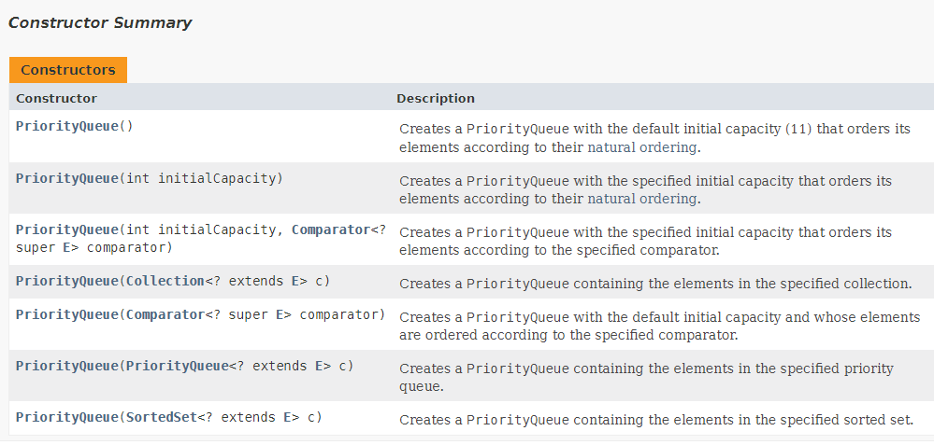
The Priority Queue

Slide 26
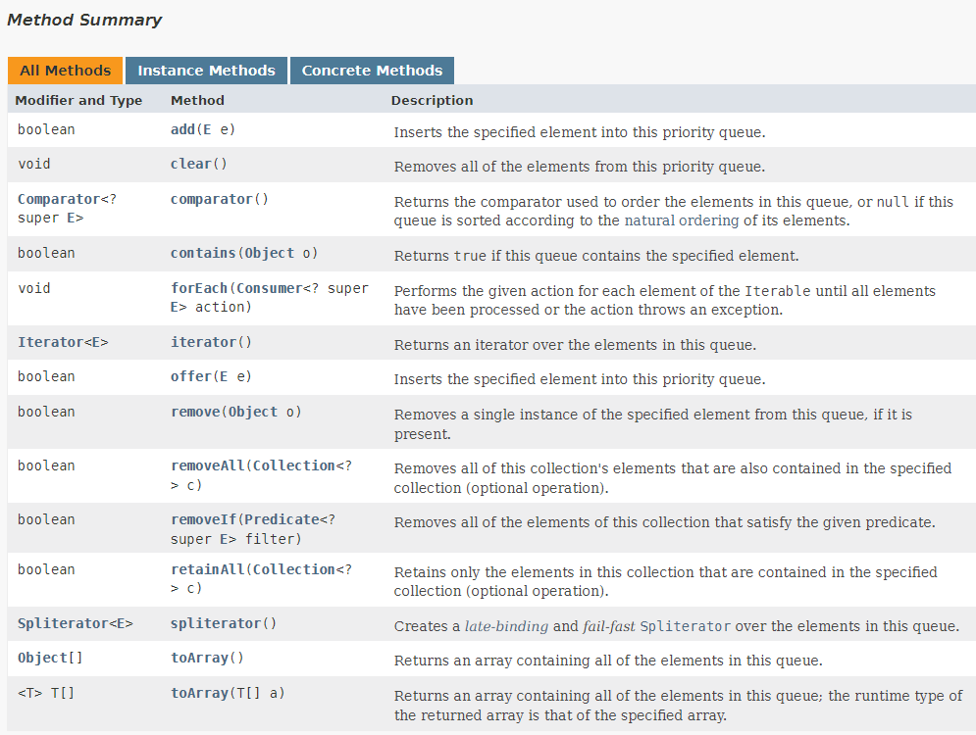
The Priority Queue

Slide 27
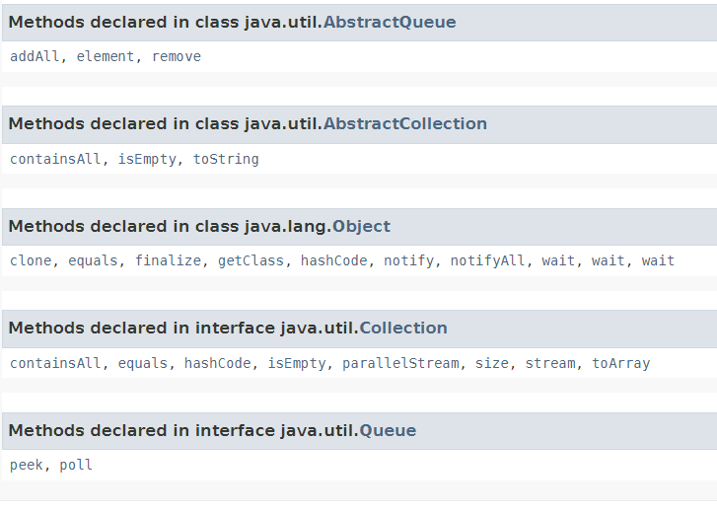
The Priority Queue

Slide 28
Using a Priority Queue
import java.util.*;
class PriorityQueueDemo {
// Main Method
public static void main(String args[])
{
// Creating empty priority queue
PriorityQueue<Integer> pQueue = new PriorityQueue<Integer>();
// Adding items to the pQueue using add()
pQueue.add(10);
pQueue.add(20);
pQueue.add(15);
// Printing the top element of PriorityQueue
System.out.println(pQueue.peek());
// Printing the top element and removing it
// from the PriorityQueue container
System.out.println(pQueue.poll());
// Printing the top element again
System.out.println(pQueue.peek());
}
}

Slide 29
Heap Sort

Slide 30
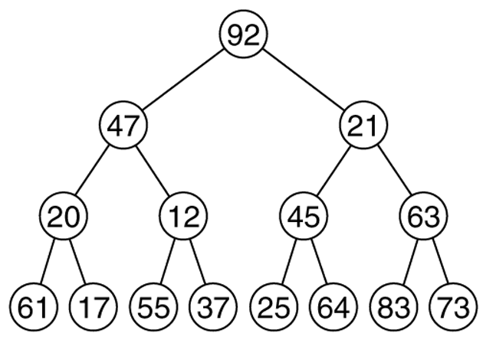
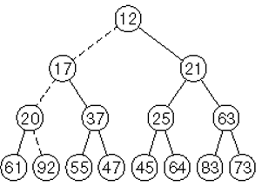
Heap sort
heap sort: An algorithm to sort an array of N elements by turning the array into a heap, then calling remove N times.
The elements will come out in sorted order.
We can put them into a new sorted array.
What is the runtime?

Slide 31
Heap sort implementation
public static void heapSort(int[] a) {
PriorityQueue<Integer> pq =
new HeapPriorityQueue<Integer>();
for (int n : a) {
pq.add(n);
}
for (int i = 0; i < a.length; i++) {
a[i] = pq.remove();
}
}
This code is correct and runs in O(N log N) time but wastes memory.
It makes an entire copy of the array a into the internal heap of the priority queue.
Can we perform a heap sort without making a copy of a?

Slide 32
Improving the code
Idea: Treat a itself as a max-heap, whose data starts at 0 (not 1). Math gets ugly here.
a is not actually in heap order.
But if you repeatedly "bubble down" each non-leaf node, starting from the last one, you will eventually have a proper heap.
Now that a is a valid max-heap:
Call remove repeatedly until the heap is empty.
But make it so that when an element is "removed", it is moved to the end of the array instead of completely evicted from the array.
When you are done, voila! The array is sorted.

Slide 33
Step 1: Build heap in-place
"Bubble" down non-leaf nodes until the array is a max-heap:
int[] a = {21, 66, 40, 10, 70, 81, 30, 22, 45, 95, 88, 38};
Swap each node with its larger child as needed.
Remember that this is a
max heap. So replace
it with the larger child.
21
66
40
10
70
81
30
22
45
95
88
38

Slide 34
Build heap in-place answer
95
88
81
45
70
40
30
22
10
66
21
38

Slide 35
Remove to sort
Now that we have a max-heap, remove elements repeatedly until we have a sorted array.
Move each removed element to the end, rather than tossing it.
95
88
81
45
70
40
30
22
10
66
21
38

Slide 36
Remove to sort answer
95: move 38 up, swap with 88, 70, 66
88: move 21 up, swap with 81, 40
81: move 38 up, swap with 70, 66
70: move 10 up, swap with 66, 45, 22
66
45
40
22
38
21
30
10
70
81
88
95

Slide 37
And….. We’re Done!

Slide 38
Class Overview
What have we learned?

Slide 39
What did we cover?
Polymorphism
Inheritance/Interfaces
Lists
ArrayLists
LinkedLists
Java Collections
Sets/Maps/Lists
Recursion
Searching/Sorting
Stacks/Queues
Trees / Binary Trees
Hashes/Heaps(Priority Queues)
Big O notation.

